Slide 1
Advanced Modeling for Distribution Planning with OpenDSS
Instructor
Roger C. Dugan Sr. Technical Executive Sacramento, California June 22-23, 2017

Slide 2

Instructor
Roger C. Dugan, Life Fellow, IEEE
Roger is a Sr. Technical Executive with EPRI in Knoxville, Tennessee USA. He has over 45 years of combined experience in distribution engineering with EPRI, Electrotek Concepts, and Cooper Power Systems. He holds the BSEE degree from Ohio University and the Master of Engineering in Electric Power Engineering degree from Rensselaer Polytechnic Institute, Troy, NY. Roger has worked on many diverse aspects of power engineering over his career because of his interests in applying computer methods to power system simulation. Beginning with a student internship with Columbus and Southern Ohio Electric Co, his work has been focused on Distribution Engineering. He was elected a Fellow of the IEEE for his contributions in harmonics and transients analysis. Recently, he has been very active in distributed generation, particularly as it applies to utility distribution systems and distribution system analysis. He was the 2005 recipient of the IEEE Excellence in Distribution Engineering Award. He is coauthor of Electrical Power Systems Quality published by McGraw-Hill, now in its 3rd edition. He serves on the IEEE PES Distribution System Analysis Subcommittee and is active in the Distribution Test Feeders WG.

Slide 3
PVSystem Model

Slide 4
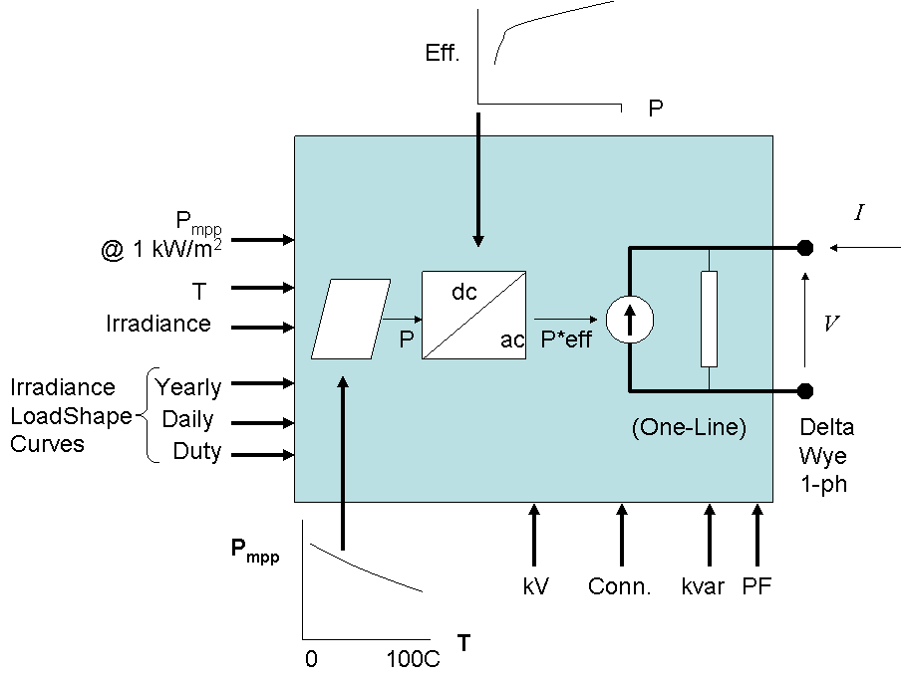
PVSystem in the OpenDSS
The PVSystem model combines a model of the PV array and the PV inverter into one convenient model to use for distribution system impacts studies

Slide 5
Example Script
This example defines a PV system with a panel Pmpp of 500 kW at 1 kW/m² irradiance and a panel temperature of 25°C. The inverter is rated at 500 kVA. A PF of 1.0 is assumed for this example.
Can also be used with the InvControl control object that implements advanced (‘smart’) inverter functions such as volt-var, volt-watt, and dynamic reactive current.
InvControl usage to be covered later today

Slide 6
Example Script
clear
New Circuit.PVSystem basekv=12.47 Isc3=1000 Isc1=900
// P-T curve is per unit of rated Pmpp vs temperature
// This one is for a Pmpp stated at 25 deg
New XYCurve.MyPvsT npts=4 xarray=[0 25 75 100] yarray=[1.2 1.0 0.8 0.6]
// efficiency curve is per unit eff vs per unit power
New XYCurve.MyEff npts=4 xarray=[.1 .2 .4 1.0] yarray=[.86 .9 .93 .97]
// per unit irradiance curve (per unit if "irradiance" property)
New Loadshape.MyIrrad npts=24 interval=1 mult=[0 0 0 0 0 0 .1 .2 .3 .5 .8 .9 1.0 1.0 .99 .9 .7 .4 .1 0 0 0 0 0]
// 24-hr temp shape curve
New Tshape.MyTemp npts=24 interval=1 temp=[25, 25, 25, 25, 25, 25, 25, 25, 35, 40, 45, 50 60 60 55 40 35 30 25 25 25 25 25 25]
// **** plot tshape object=mytemp
// take the default line
New Line.line1 Bus1=sourcebus bus2=PVbus Length=2

Slide 7
Example Script (cont’d)
! PV definition
New PVSystem.PV phases=3 bus1=PVbus kV=12.47 kVA=500 irrad=0.8 Pmpp=500
~ temperature=25 PF=1 effcurve=Myeff P-TCurve=MyPvsT
~ Daily=MyIrrad TDaily=MyTemp
set voltagebases=[12.47]
calcv
solve ! solves at the specified irradiance and temperature
new monitor.m1 PVSystem.PV 1 mode=1 ppolar=no
new monitor.m2 PVSystem.PV 1
solve
solve mode=daily
show mon m1
show mon m2

Slide 8
Example Script (cont’d)
Export monitors m1
Plot monitor object= m1 channels=(1 )
Export monitors m2
Plot monitor object= m2 channels=(1 ) base=[7200]
Export monitors m2
Plot monitor object= m2 channels=(9 )

Slide 9
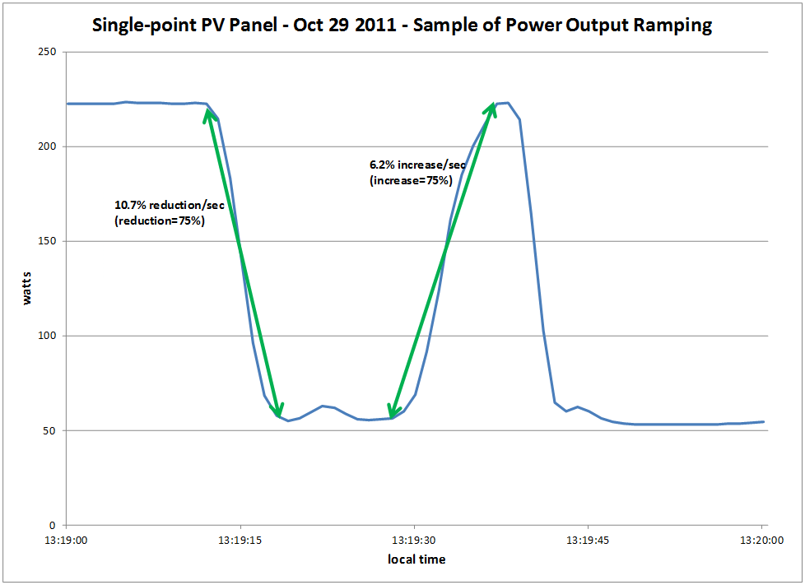
Modeling PV Systems – Variability/Ramping – Single-Panel

Slide 10
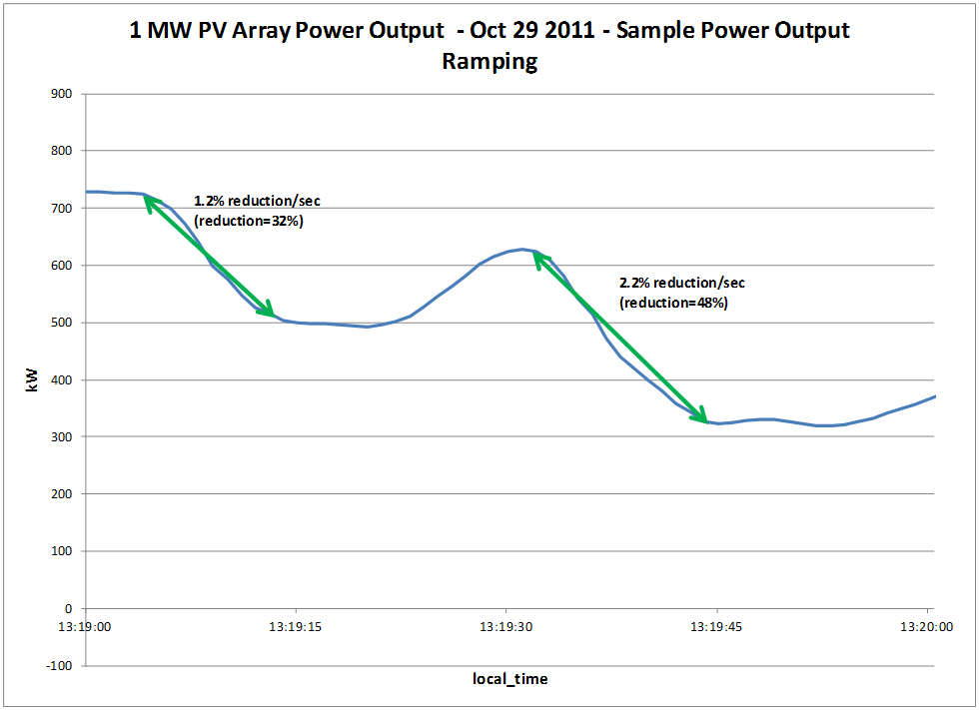
Modeling PV Systems – Variability/Ramping – 1 MW PV Array (same location as Single-Panel)

Slide 11
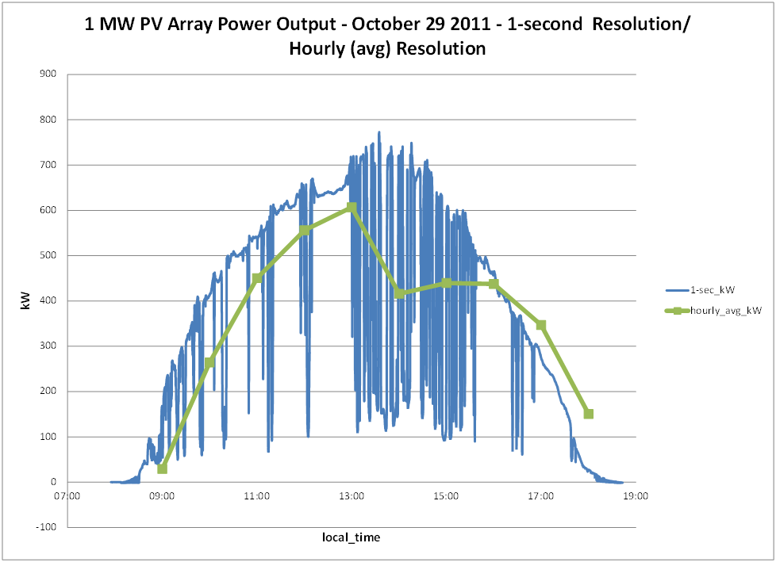
Modeling PV Systems – Variability/Ramping – Significance of Solar Irradiance Resolution

Slide 12
Modeling PV Systems for Distribution System Impact Assessment – Fault Response
Fault current contribution
Conservative Rule-of-thumb: 2 x Full Output Rating of Inverter for 1 cycle (three-phase fault)
Other testing has been performed by Southern California Edison, NREL, PV inverter manufacturers, etc
Inverters generally shut down at 1.2 pu of rated current
May be 3-4 times pre-fault current
Irregular behavior on voltage sags
Tries to hold constant power (current increases)
May become discontinuous

Slide 13
‘Smart’ Inverter Control in the OpenDSS

Slide 14
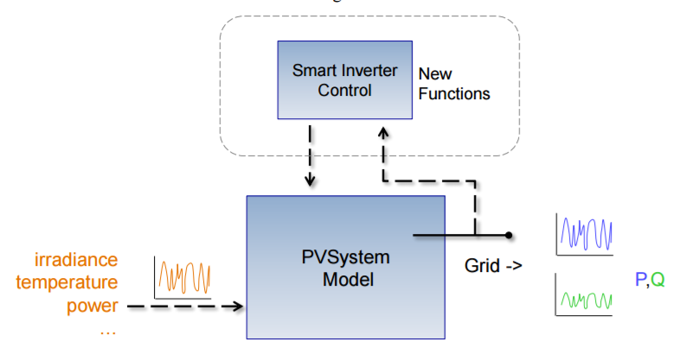
Inverter Control Manages One or More PVSystems

Slide 15
InvControl Control Object
Works in conjunction with PVSystem object(s) to control the PVSystem(s) output according to ‘smart’ inverter functions
Three modes currently available:
Volt-var
Follows a voltage versus reactive power curve and changes the reactive power generation (capacitive) or reactive power absorption (inductive) according to the terminal voltage at each PVSystem
Volt-watt
Follows a voltage versus active power curve and changes the active power output according to the terminal voltage at each PVSystem (within the limits of the present irradiance)
Dynamic Reactive Current (DRC)
Has several settings that change the reactive power generation or absorption in response to fast changes in terminal voltage (e.g., during a sag or swell)

Slide 16
Volt-var Control Mode – Example Volt-var Curve

Slide 17
InvControl in Volt-var Mode – Script
New PVSystem.3P_ExistingSite4 phases=3 bus1=B51854_sec kV=0.4157 kVA=523 ~ irradiance=1 Pmpp=475 pf=1 %cutin=0.1 %cutout=0.1 yearly=PV_ls
New PVSystem.3P_ExistingSite1 phases=3 bus1=X_5865228330A kV=0.4157 kVA=314 ~ irradiance=1 Pmpp=285 pf=1 %cutin=0.1 %cutout=0.1 yearly=PV_ls
New PVSystem.3P_ExistingSite3 phases=3 bus1=X_5891328219_Cust1 kV=0.4157 ~ kVA=836 irradiance=1 Pmpp=760 pf=1 %cutin=0.1 %cutout=0.1 yearly=PV_ls
New PVSystem.3P_ExistingSite2 phases=3 bus1=B4832_sec kV=0.4157 kVA=209 ~ irradiance=1 Pmpp=190 pf=1 %cutin=0.1 %cutout=0.1 yearly=PV_ls
New XYCurve.vv_curve npts=4 Yarray=(1.0,1.0,-1.0,-1.0) ~ XArray=(0.5,0.95,1.05,1.5)
New InvControl.InvPVCtrl mode=VOLTVAR voltage_curvex_ref=rated ~ vvc_curve1=vv_curve EventLog=yes

Slide 18
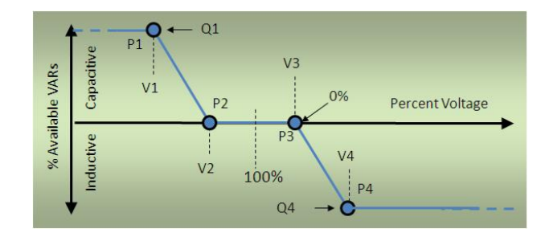
Volt-Var Control Mode – with a Dead Band

Slide 19
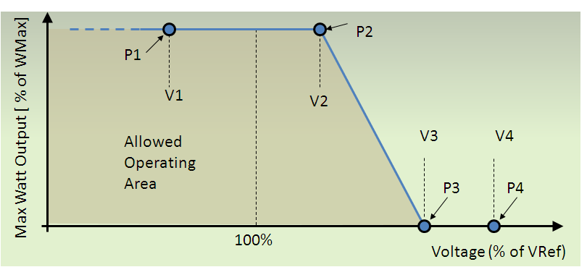
Volt-watt Control Mode – Example Volt-watt Curve

Slide 20
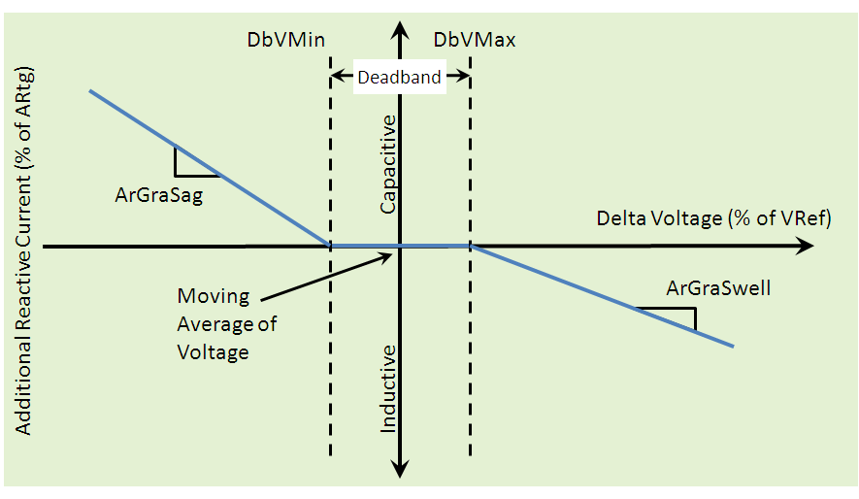
DRC Control Mode – Settings Curve

